Slide 1



YOUR LOGO
Digital Education in Ontario, Canada
Sherry Liang
Assistant Commissioner
Office of the Information & Privacy Commissioner of Ontario

Slide 2
Office of the Information and Privacy Commissioner of Ontario (IPC)
What we do:
Provide an independent review of provincial and municipal government and public sector decisions and practices concerning access and privacy
Oversee compliance with provincial and municipal access and privacy legislation
Conduct research and deliver education and guidance on access and privacy issues

Slide 3
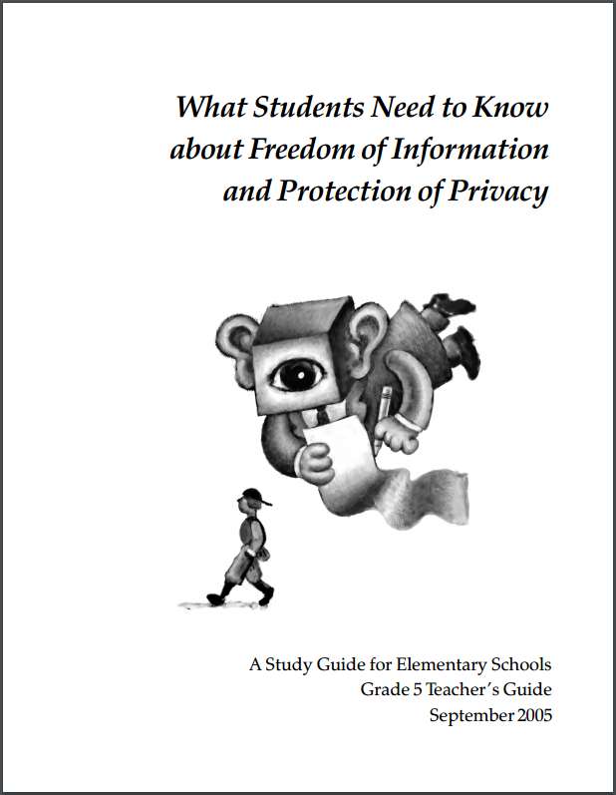
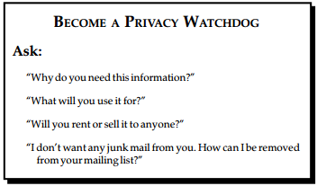
Grade 5 students (ages 10-11 years)
Available online: https://www.ipc.on.ca/wp-content/uploads/Resources/up-1grade_5.pdf

Slide 4
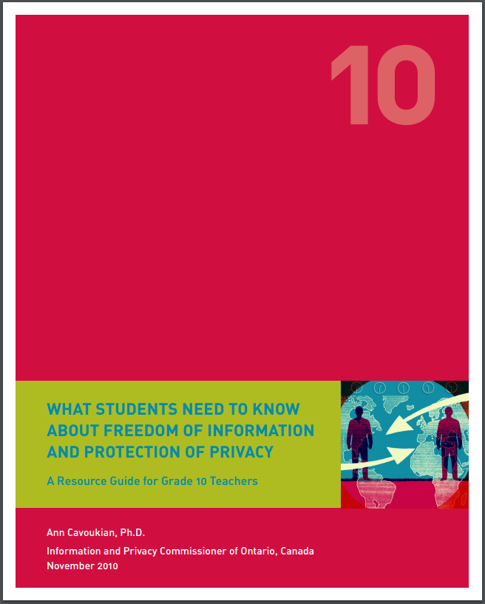
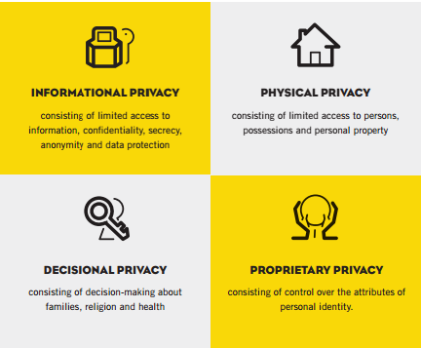
Grade 10 students (ages 15-16 years)
Available online: https://www.ipc.on.ca/wp-content/uploads/Resources/Grade_10_web-e.pdf

Slide 5
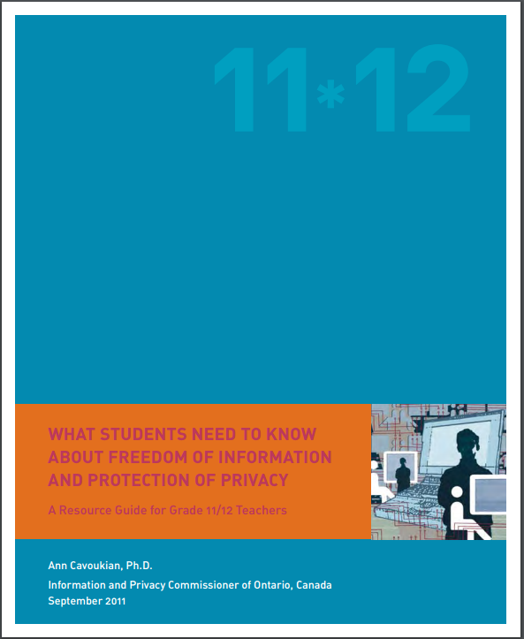
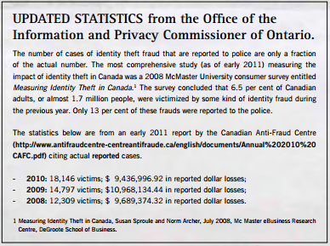
Grade 11-12 students (ages 16-18 years)
Available online: https://www.ipc.on.ca/wp-content/uploads/Resources/Grade_11-12_Resource_Guide.pdf

Slide 6
Educational Materials for Youth
Collaborative Approach:
  Frontline teachers participated in the development of our educational materials
  School boards that oversee public schools in Ontario participated by distributing guidance
Seamless Integration
  Materials were based on the curriculum standards required by the Ministry of Education to allow them to seamlessly join existing teaching plans
  Lessons based on existing plans in use by school boards
  Teachers do not require additional training in order to teach this material

Slide 7
Approach Taken
Separate materials developed based on age group.
Variety of learning tools, including:
  Powerpoint presentations to be given by teachers
  Online research activities
    For example, “webquests” where students visit specific websites to find privacy policies and information
    Videos shown in class
    Quizzes
    Quick reference infographics
    Group discussion aids
    Case studies
    Discussion aids around articles that relate to privacy in the news
    MTV News video featuring former commissioner on online reputation, included in course: https://www.youtube.com/watch?v=vl8lNvVQVNY

Slide 8

Infographics:
Easy to remember list of potential viewers of online content
Reminder to kids that online posts are not private and can be seen by the wrong people
Focus on thinking before you post

Slide 9
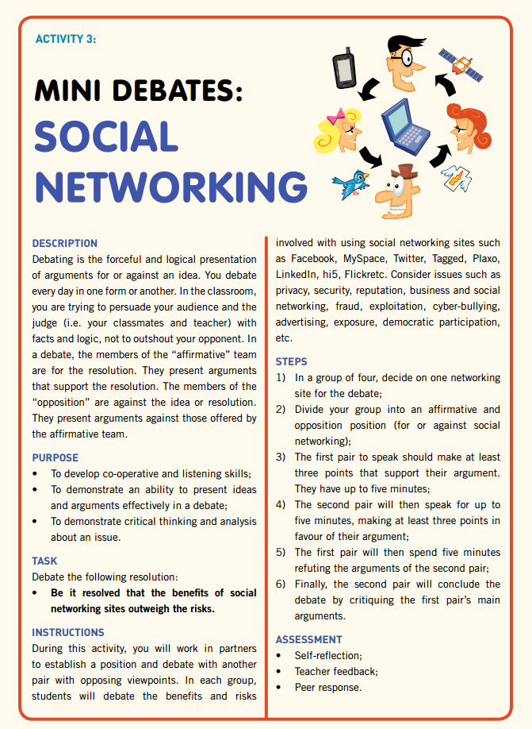
Debate Exercises:
Students work in small teams to assess and debate the merits of various social networking platforms
Students independently consider issues such as privacy, security, reputation and cyber-bullying, while simultaneously considering the benefits of using social networks

Slide 10
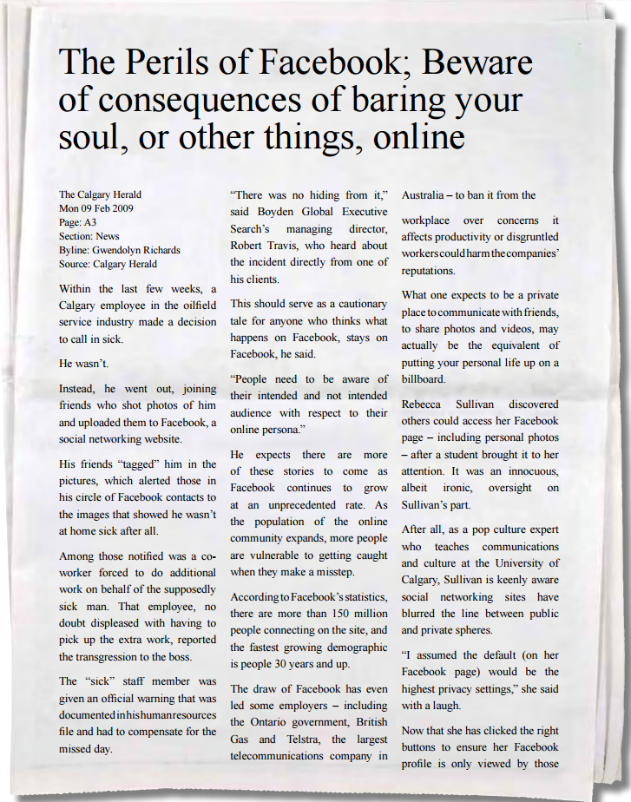
News Articles
Students are provided with real news articles dealing with the potential consequences of revealing personal information online
Students are invited to discuss the articles and consider their own use of social media and the potential impacts to reputation and privacy

Slide 11
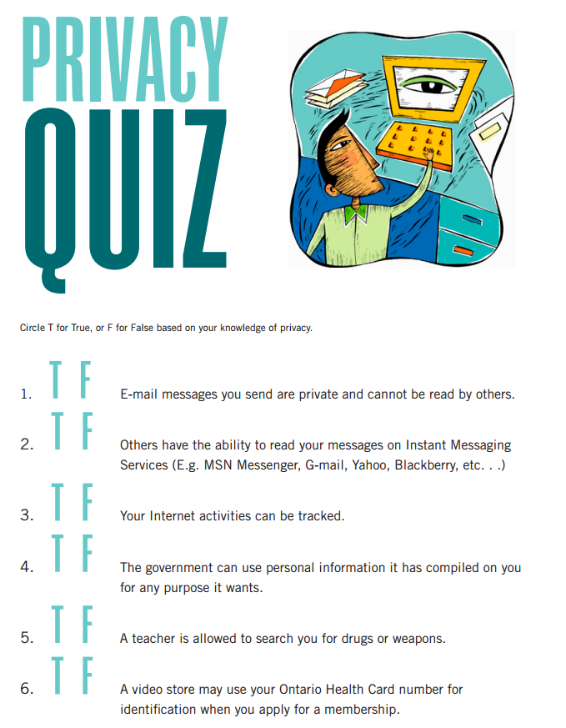
Short Quizzes
Quizzes vary in complexity based on target age groups
The questions have been designed to start conversations on privacy rights and technology

Slide 12
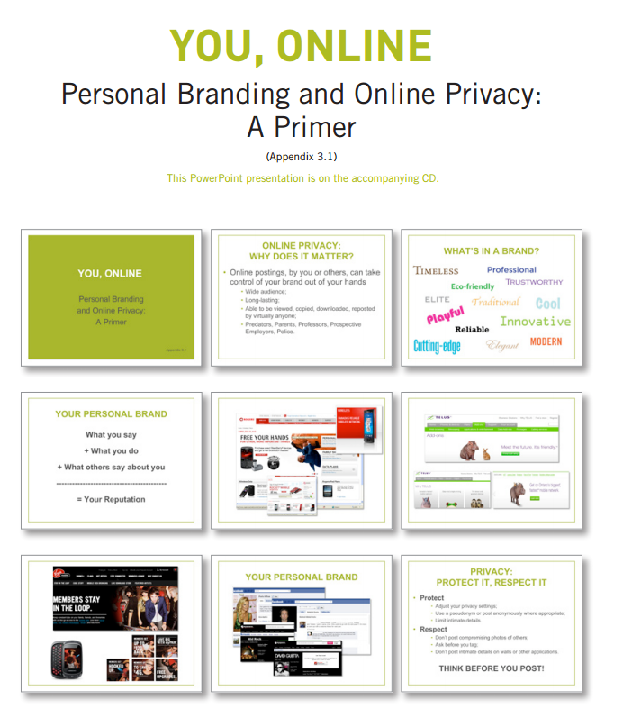
Powerpoint Presentations
Slide decks provide teachers with easy to use lecture tools that focus on issues like online privacy and reputation
Presentations use numerous examples from websites and social media to help students understand the impact of online privacy on their lives

Slide 13
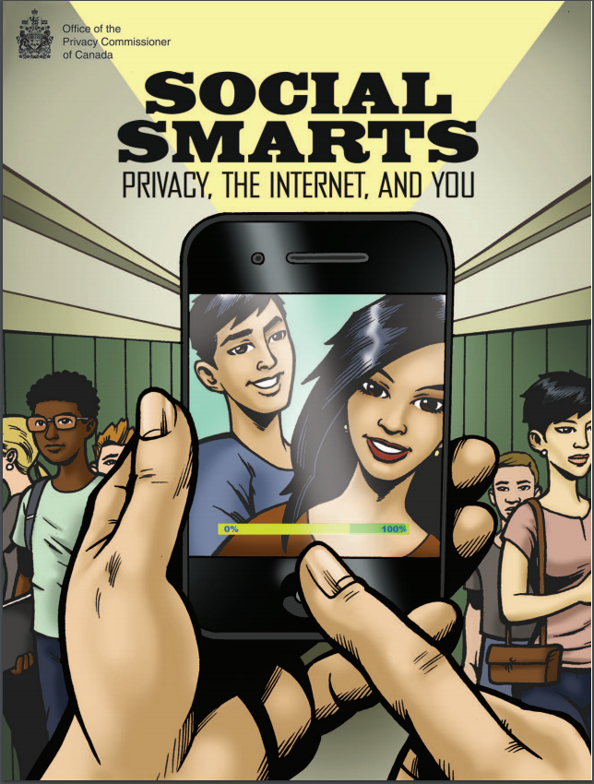

Examples of Resources Across Canada
The Office of the Privacy Commissioner of Canada developed this graphic novel following two teens dealing with privacy and social media
La Commission d’accès à l’information du Québec created this educational program to teach kids the rules of protecting personal information

Slide 14
Contact Us
Information and Privacy Commissioner of Ontario
2 Bloor Street East, Suite 1400
Toronto, Ontario, Canada
M4W 1A8
Phone: (416) 326-3333 / 1-800-387-0073
TDD/TTY: 416-325-7539
Web: www.ipc.on.ca
E-mail: info@ipc.on.ca
Media: media@ipc.on.ca / 416-326-3965

