Slide 1
Access and Privacy Update
Renee Barrette, Director of Policy
Lauren Silver, Policy Analyst
Information and Privacy Commissioner of Ontario
AMCTO Zone 4 Spring Meeting
May 2, 2017

Slide 2
Our Office
The Information and Privacy Commissioner (IPC) provides an independent review of government decisions and practices concerning access and privacy
The Commissioner is appointed by and reports to the Legislative Assembly; and remains independent of the government of the day to ensure impartiality

Slide 3
The Three Acts
The IPC oversees compliance with:
Freedom of Information and Protection of Privacy Act (FIPPA)
Municipal Freedom of Information and Protection of Privacy Act (MFIPPA)
Personal Health Information Protection Act (PHIPA)

Slide 4
Mission, Mandate and Values
MISSION: We champion and uphold the public’s right to know and right to privacy
MANDATE: We resolve access to information appeals and privacy complaints, review and approve information practices, conduct research and deliver education and guidance on access and privacy issues, and comment on proposed legislation, programs and practices
VALUES: Respect, Integrity, Fairness, Collaboration and Excellence

Slide 5
Agenda
Access
  Third Party Information and Contracts
  Frivolous and Vexatious Requests
Privacy
  Records and Information Management
  Instant Messaging and Personal Email Accounts
  Publishing on the Internet
  Video Surveillance
IPC Update
  Recent work on Legislative Reform
  New IPC Resources

Slide 6
Access

Slide 7
Total Access Requests Per Year

Slide 8
Total Appeals Received Per Year
2006

Slide 9
Total Access to Information Orders

Slide 10
Third Party Information
Section 10(1) of MFIPPA sets out a mandatory exemption for third party information
Third party information shall not be disclosed if:
  it reveals a trade secret or scientific, technical, commercial, financial or labour relations information,
  is supplied in confidence, and
  where the disclosure could lead to certain types of harms

Slide 11
Example: Third Party Information and Contracts
IPC Order PO-3598
Access request to Ryerson University for an agreement between it and TD Bank relating to the issuance of university-branded credit cards
Ryerson granted partial access to the agreement, withholding some information in reliance on the exemption for third party information at section 17(1) of the FIPPA
On appeal, IPC found that none of the information in the agreement was “supplied” to the university in confidence and, therefore, section 17(1) does not apply
IPC ordered Ryerson to disclose the agreement in its entirety to the requester

Slide 12
Judicial Review of PO-3598
Toronto-Dominion Bank v Ryerson University, 2017 ONSC 1507
The Divisional Court dismissed the application and upheld the IPC’s decision
“…The adjudicator’s approach is consistent with the
purpose of the Act, namely that information should be available to the public and exemptions should be limited
and specific.” (para 34)
TD has sought leave to appeal the decision to the Court of Appeal

Slide 13
Frivolous and Vexatious Requests
Section 4(1)(b) creates an exception to the right of access where the institution is of the opinion on reasonable grounds that the request for access is frivolous or vexatious
Section 5.1 of Regulation 823 explains that a request is frivolous or vexatious if the request is:
  part of a pattern of conduct that amounts to an abuse of the right of access;
  part of a pattern of conduct that would interfere with the operations of the institution;
  made in bad faith; or
  made for a purpose other than to obtain access

Slide 14
Frivolous and Vexatious Requests
The threshold for claiming the frivolous or vexatious exemption is high, and it will generally not be successful if institutions simply claim they do not have enough resources
Detailed documentation of interactions with the requester is key to success

Slide 15
What makes a request frivolous or vexatious?
Number of requests
Nature and scope of requests – excessively broad/identical to previous requests
Timing of requests – connected to some other event
Purpose of requests – “nuisance” value/harass government/burden system
Nature and quality of interaction/contact between requester and FOI staff

Slide 16
Example: Frivolous and Vexatious Requests
IPC Order MO-2488
High number of requests: 54 requests with 372 parts in total (an average of 6.5 parts per request)
Requests excessively broad and unusually detailed: Open ended wording (“any and all”, “including but not limited to”)
Purpose of the request for an objective other than access: The appellant already possessed many of the emails requested
Timing of the requests: The close timing of appellant’s lawsuit and requests was a relevant factor in favour of finding an abuse of the right of access

Slide 17
MO-2488 (cont’d)
The adjudicator imposed conditions on the processing of the appellant’s requests:
For a period of one year, only one transaction by the appellant may proceed at any given point in time
The City may decide the order in which it wishes to process the remaining requests the appellant would like to keep open
After the one year period, the appellant or the City may apply to the IPC to ask that the conditions be varied. Otherwise, the conditions continue in effect until such time as a variance is sought and ordered.

Slide 18
MO-2488 (cont’d)
In addition, the adjudicator imposed conditions on the appellant:
The appellant must specify the exact information or records sought, and if possible, the location in which the records may be found
Each request must only deal with one subject matter and must seek specific information, and will not include the phrases “any and all” and “but not limited to”
Apart from the request, the appellant or a representative of the appellant cannot otherwise contact the City (verbally or written), unless the City initiates the contact to clarify the request
Otherwise, the City is not required to respond to the appellant

Slide 19
Example: Frivolous and Vexatious Requests
IPC Order MO-3049
A municipality claimed that three requests for access to its cheque registry and credit card expenses were frivolous or vexatious pursuant to s. 4(1)(b) MFIPPA
Municipality argued that due to its small size and budget, it cannot employ a full-time FOIP coordinator, and the person with those duties often finds it difficult to respond to requests within the 30 day limit
The IPC found that the requests were not frivolous or vexatious and ordered the town to provide a decision letter in response to the requests

Slide 20
IPC Order MO-3049 (cont’d)
The IPC provided suggestions to improve the efficiency of the town’s FOIP system given its small size:
Publish responses to FOI requests on the town’s website
Be more proactive about releasing information
Seek a time extension in accordance with s. 20(1) MFIPPA
Utilize fee provisions set out in s. 45(1) MFIPPA
Provide reasons for refusing access as required by s. 20.1(1)(b) when claiming that the request is frivolous or vexatious

Slide 21
Privacy

Slide 22
Total Privacy Complaints
Opened Per Year

Slide 23
RIM Guidance
Effective records and information management (RIM) practices help institutions meet legal requirements and better serve the public
Institutions are better able to:
  respond to access requests in a timely way
  be transparent and accountable to the public
  ensure the confidentiality and privacy
Publication describes best practices and how to enhance the public’s ability to access information

Slide 24
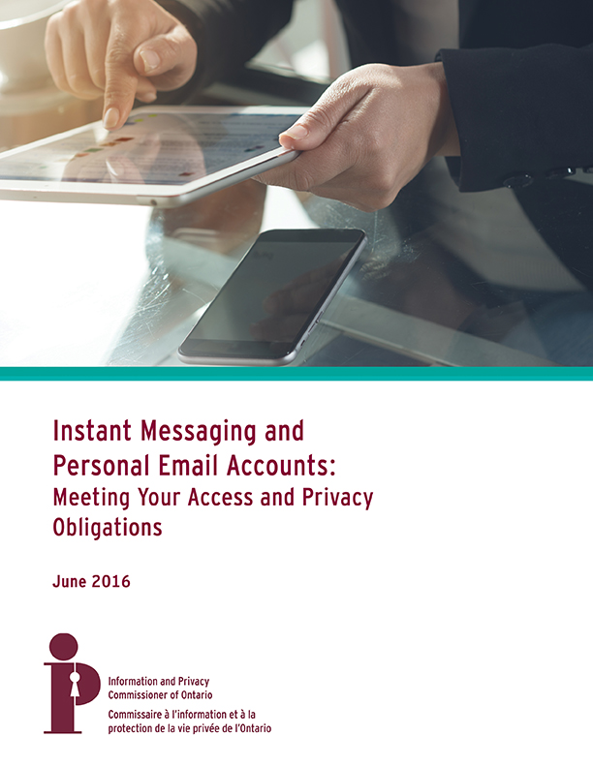
Instant Messaging &
Personal Email Accounts
Emails sent and received from personal email accounts and instant messages are subject to access requests
Challenges in managing records produced using personal email or instant messaging include:
  Search and production when responding to access to information requests
  Retention and preservation in compliance with the acts
  Ensuring privacy and security of personal information
We advise institutions to prohibit use or enact measures to ensure business records are preserved

Slide 25
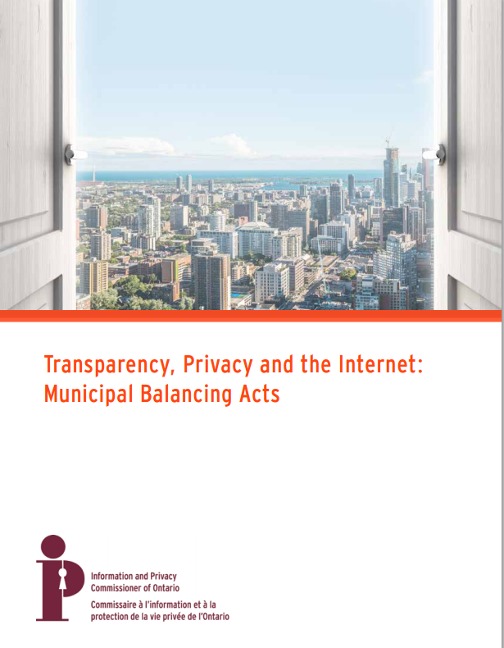
Publishing on the Internet
IPC Guidance
This guide provides municipalities with privacy protective policy, procedural and technical options when publishing personal information online The focus is primarily on personal information that is required by legislation to be published, but may be applied in any situation where municipalities make information available online

Slide 26
Publishing on the Internet
IPC Guidance
Privacy protection may be improved through a number of risk mitigation strategies:
      Transparent administration
        When information received or video is recorded (e.g., council meetings), provide clear notice about how it will be published; manage expectations
Redaction
  Develop a process where individuals can have their information redacted in certain circumstances; remove unnecessary information
  Data minimization
    Request and store only as much personal information as is necessary
    Technological measures to limit searchability
      e.g., robot exclusion protocols, images instead of text

Slide 27
Example: Publishing on the Internet
Privacy Complaint Report MC13-67
A complaint was received about a municipality’s online publication of personal information collected as part of a minor variance application
IPC found that the publication of this information was not in contravention of the MFIPPA because the published information was required to be made publicly available under the Planning Act
IPC, however, recommended that the City consider implementing privacy protective measures that obscure this type of information from search engines and automated agents

Slide 28
Example: Publishing on the Internet
Complainant was a member of a profession regulated by an administrative tribunal. As a result of a complaint about him, the tribunal initiated a proceeding, concluding that the complainant had breached his professional duties, and imposed a lifetime ban on practicing within his profession.
Complainant alleged that internet publication of the tribunal’s decision was a violation of his privacy.
IPC dismissed the complaint at the intake stage:
  Tribunal had the authority to investigate and impose sanctions
  Continuing publication of the information about the complainant was consistent with the purpose for which it was collected, and not a breach of FIPPA

Slide 29
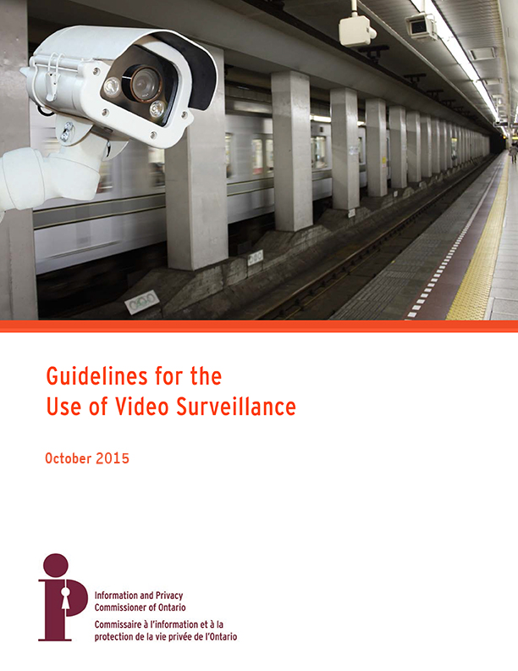
Video Surveillance Guidelines
IPC published video surveillance guidelines in 2015
This guide consolidates previous advice provided by the IPC and presents new issues and factors to consider, including retention periods and notices of collection
It also provides key messages and examples for clarity

Slide 30
Video Surveillance Guidelines
Best practices for municipalities implementing a video surveillance program include:
  Consulting your Freedom of Information and Privacy Coordinator and the public
  Conducting a privacy impact assessment (PIA)
  Establishing policies and procedures
  Establish a privacy breach protocol
  Training employees
  Auditing roles, responsibilities and practices

Slide 31
Video Surveillance Guidelines
Municipalities should be prepared to process access requests from the public including developing protocols for the redaction of personal information from the video, where appropriate
Municipalities may use tools and techniques such as:
  Digitizing analogue footage to enable the use of more powerful editing tools,
  Blacking out or blurring images of individuals, and
  Removing the sound of voices
Retention period for unused images should be limited to the amount of time reasonably necessary to discover or report an incident

Slide 32
IPC Update

Slide 33
Recent Work on
Legislative Reform

Slide 34
Bill 119, Amendments to PHIPA
Amendments that have been proclaimed in force include:
  Privacy breaches meeting a threshold must be reported to IPC
  Threshold on reporting to IPC to be prescribed in regulation
  Six month time limit on laying charges under PHIPA removed
  Fines for offences under PHIPA doubled from $50,000 to $100,000 for individuals and $250,000 to $500,000 for organizations
  Persons other than Attorney General may commence prosecution, with AG’s consent
Amendments related to the provincial electronic health record have not been proclaimed in force

Slide 35
Bill 89, Supporting Children,
Youth and Families Act
Bill 89 creates a new Child, Youth and Family Services Act
Part X sets out rules for the collection, use and disclosure of personal information by child, youth and family service providers (e.g., Minister of Children and Youth Services, Children’s Aid Societies)
Child, youth and family service providers will be subject to new privacy and access rules overseen by the IPC

Slide 36
Bill 89, Supporting Children,
Youth and Families Act
March 2017, IPC submission to the Standing Committee focused on significant privacy issues:
  the ministry must be subject to a greater degree of accountability and oversight than what is currently provided
  the bill should be amended to strengthen privacy safeguards and to narrow the ministry’s powers to collect, use and disclose personal information to what is reasonably necessary
  the authority to share personal information among government organizations and to disclose it to persons and entities that are not prescribed in the regulations must be removed from the legislation

Slide 37
Bill 68, Modernizing Ontario's Municipal Legislation Act
IPC Submission to Standing Committee on April 10
Bill 68 proposes to expand open meeting exceptions of the Municipal Act and City of Toronto Act
Could restrict the public’s right of access - public may be excluded from more meetings
Expanding the circumstances for closed meetings could lead to more refusals to disclose information

Slide 38
Bill 68, Modernizing Ontario's Municipal Legislation Act
No evidence that these exceptions need to be expanded
Proposed amendments should be struck from the bill unless there is compelling evidence
If there is evidence, IPC recommends an amendment to limit the impact of the proposed amendments on access rights
Our amendment would ensure access requests could not be refused simply because a record was discussed in a closed meeting

Slide 39
Bill 114, Anti-Racism Act
Bill 114 requires the government to develop and maintain an anti-racism strategy, including targets and indicators
Anti-Racism Act (ARA) would require public sector organizations to collect race-based personal information and use an anti-racism impact assessment framework to promote racial equity in program delivery
The handling of race-based personal information would be subject to data standards and other privacy requirements, to be developed in consultation with the IPC

Slide 40
Bill 114, Anti-Racism Act
Privacy protections include ongoing oversight by our office, notably the authority to:
  review the collection and use of personal information by public sector organizations, and
  order an organization to change or discontinue any personal information handling practice that contravenes the ARA

Slide 41
New IPC Resources

Slide 42
New Guidance Documents
Yes, You Can
Thinking about Clouds
Instant Messaging and Personal Email Accounts
De-identification Guidelines for Structured Data
Open Government (3)
Guidance on the Use of Automated Licence Plate Recognition Technology by Police Services
Improving Access and Privacy with Records and Information Management
Online Educational Services

Slide 43
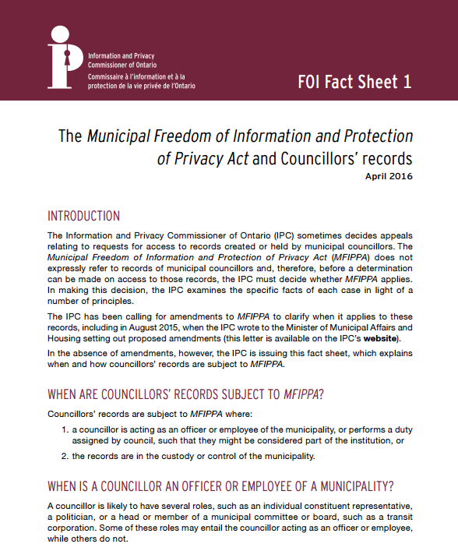
New IPC Fact Sheet Series
Published to provide information in response to frequently asked questions about access to information, privacy and technology
Series includes:
  Councillors’ Records
  What is Personal Information?
  Reasonable Search
  Video Surveillance
  Ransomware

Slide 44
New Webinar Series
New series on timely, in-demand topics about access to information and privacy issues
First two presentations are now available at ipc.on.ca:
  Situation Tables
  Understanding Exemptions in FIPPA and MFIPPA

Slide 45
Questions?

Slide 46
How to Contact Us
Information and Privacy Commissioner of Ontario
2 Bloor Street East, Suite 1400
Toronto, Ontario, Canada
M4W 1A8
Phone: (416) 326-3333 / 1-800-387-0073
TDD/TTY: 416-325-7539
Web: www.ipc.on.ca
E-mail: info@ipc.on.ca

