Slide 1



Know your rights, protect your privacy
Youth talking to youth
YOUTH ADVISORY COUNCIL
INFORMATION AND PRIVACY COMMISSIONER OF ONTARIO
STRATEGIC PRIORITY: CHILDREN AND YOUTH IN A DIGITAL WORLD

Slide 2


Roadmap
About the IPC
Your privacy rights
Privacy in your life
What can you do?
Discussion

Slide 3

What is the IPC?
The Office of the Information and Privacy Commissioner of Ontario (IPC) oversees Ontario’s access and privacy laws.
These laws give the public the right to access their personal information as well as general information from public institutions.
The laws also set rules to ensure that personal information held by public institutions, health care providers, and child and family service providers is private and secure.
What is the Youth Advisory Council?
The IPC’s Youth Advisory Council is a group of ten young people between the ages of 15 and 24.
The members help the IPC stand up for the access and privacy rights of children and youth.
If you are interested in joining the Youth Advisory Council, email youthcouncil@ipc.on.ca or visit this webpage.

Slide 4


What words come to mind when you think of privacy?
DISCUSSION QUESTION

Slide 5

What are your privacy rights?

Slide 6
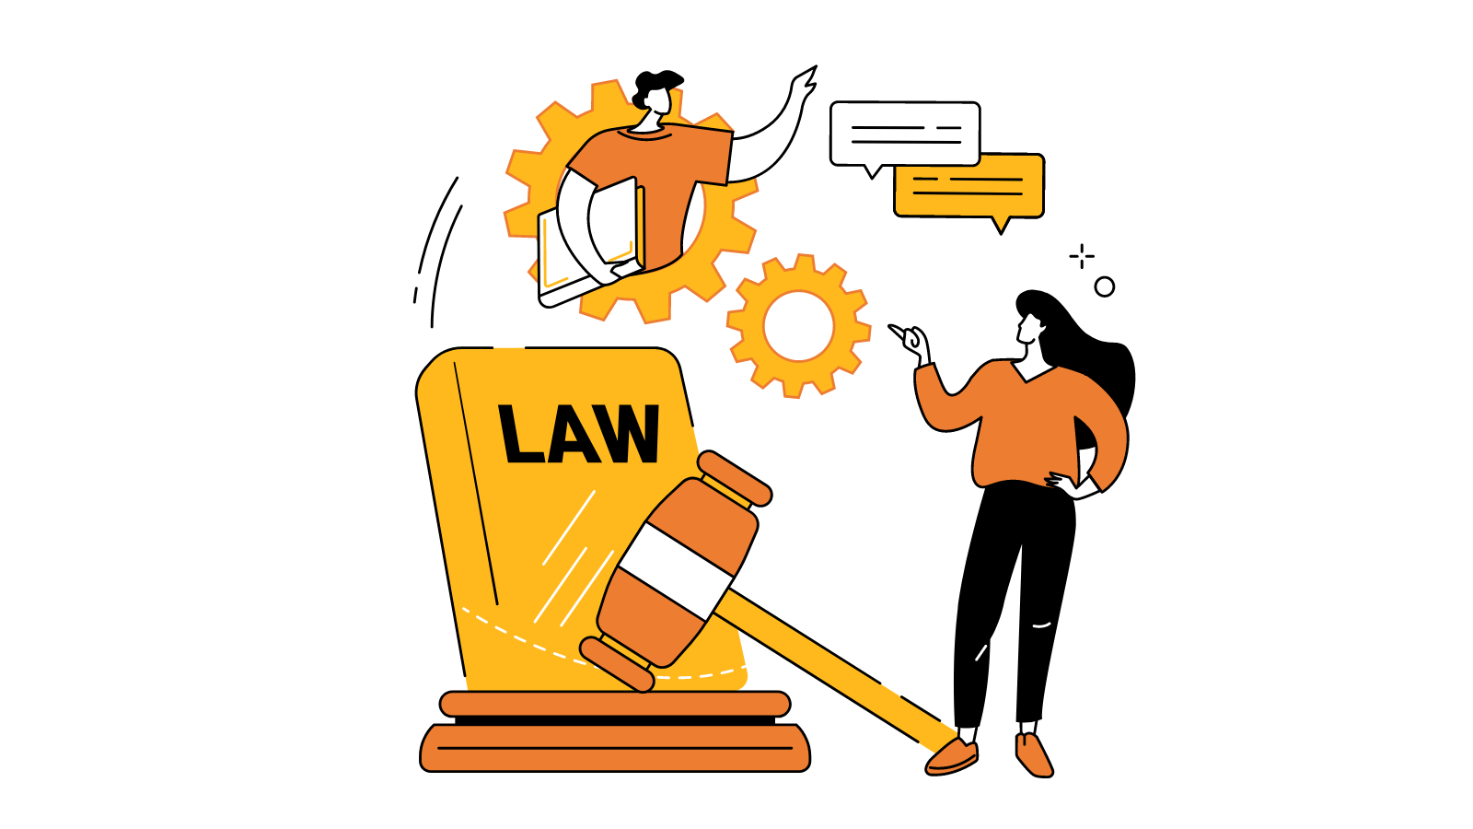
Governments and public institutions
Canada’s privacy laws require all levels of government and other public institutions to protect your personal information.
This means:
limiting the amount of personal information they collect, use, and disclose about you
these laws also require public institutions to keep your personal information safe and secure
You also have the right to:
see or get a copy of your personal information
request corrections to your information if you believe your information is incorrect, or information is missing

Slide 7

For Example:
Attending secondary school?
In Ontario, MFIPPA (the Municipal Freedom of Information and Protection of Privacy Act) requires municipalities, police service boards, schools and school boards, libraries, and transit commissions (among others) to protect your personal information.
How about post-secondary school?
In Ontario, FIPPA (the Freedom of Information and Protection of Privacy Act) requires provincial ministries, community colleges, universities, and other provincial institutions to protect your personal information.

Slide 8
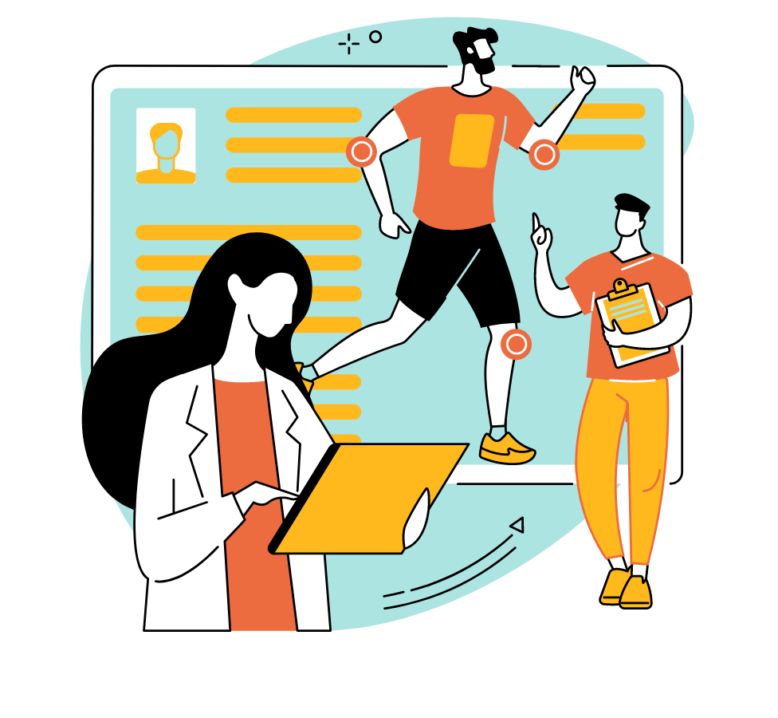
For Example:
Need to see a doctor?
In Ontario, PHIPA (the Personal Health Information Protection Act) sets the rules that health care providers must follow when they collect, use, or disclose your personal health information, and the reasonable safeguards they must have in place to keep it secure.
Receiving support from a children’s aid society, group home or other child and family service provider?
In Ontario, Part X of the CYFSA (the Child, Youth and Family Services Act) sets the rules that service providers must follow when they collect, use, or disclose your personal information.

Slide 9
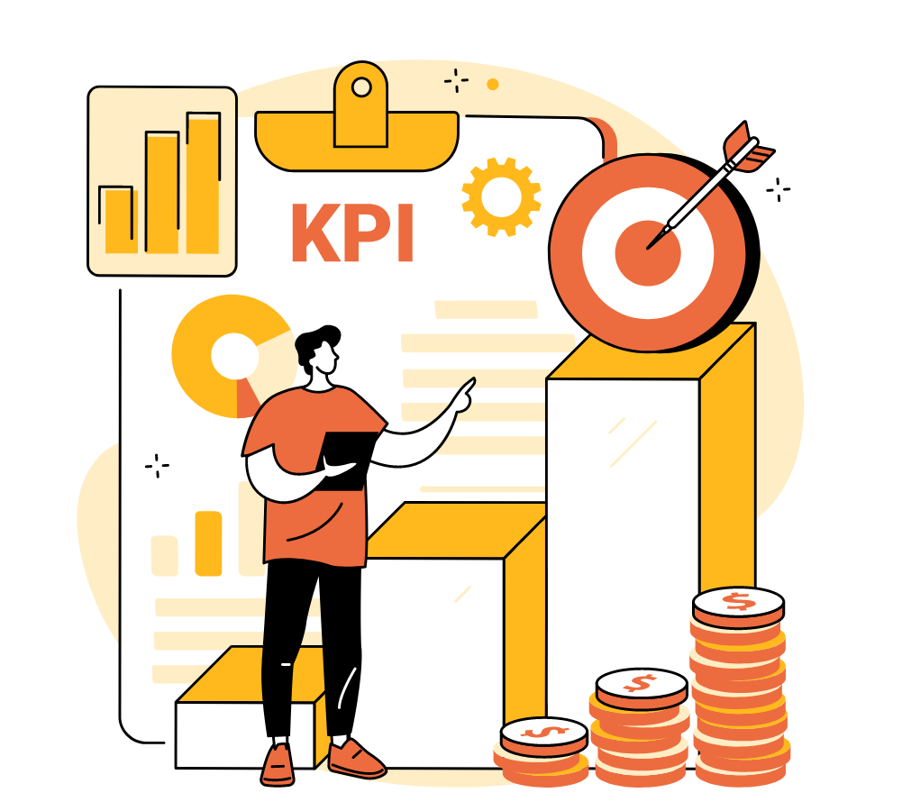
Private businesses
Commercial businesses in Ontario (like stores, banks, cell phone companies, and online platforms) must follow the rules set out in the Federal law called PIPEDA (the Personal Information and Protection of Electronic Documents Act).
These businesses must, for example:
only collect your personal information if it’s reasonable and appropriate
tell you what they intend to do with it
obtain your informed consent before using or disclosing it
protect your personal information
securely destroy it when it is no longer needed
allow you to access your own personal information, and
correct it if they got it wrong

Slide 10
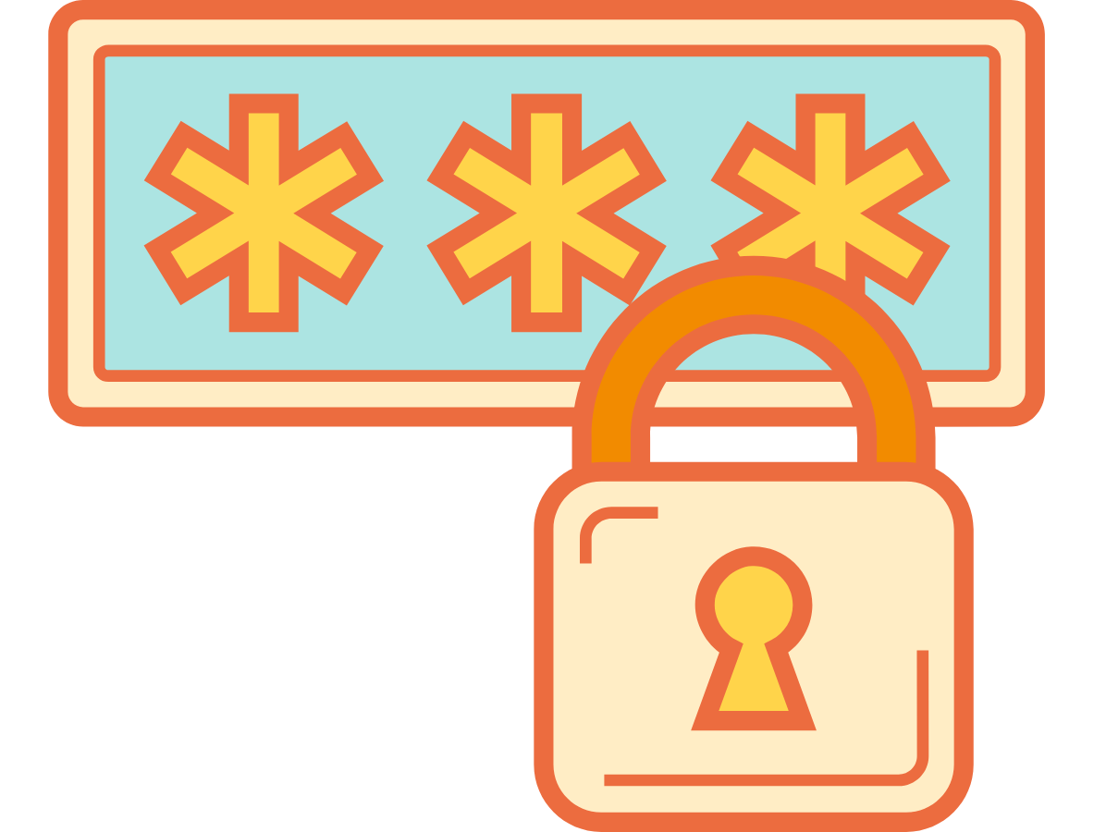
What if your privacy rights are not being respected?
If you think your personal information has been mishandled, you should first bring your concern directly to the institution or private business.
If you can’t resolve the issue directly with the organization and it is based in Ontario, you can file a formal complaint with the Information and Privacy Commissioner at www.ipc.on.ca or contact info@ipc.on.ca.
If the organization is a private business, you can file a complaint with the Federal Privacy Commissioner. Learn more at www.priv.gc.ca.

Slide 11

Privacy and you

Slide 12
When do you think about your privacy?
DISCUSSION QUESTION

Slide 13


We live most of our lives online.
We use technology to do things like:
  talk to friends and family
  participate in school
  shop or obtain other services
  work
  play games
  watch TV and movies
Many of these tools are collecting information about us, even if we don't realize it.
QUESTION: How much personal data do you think your phone collects about you?

Slide 14
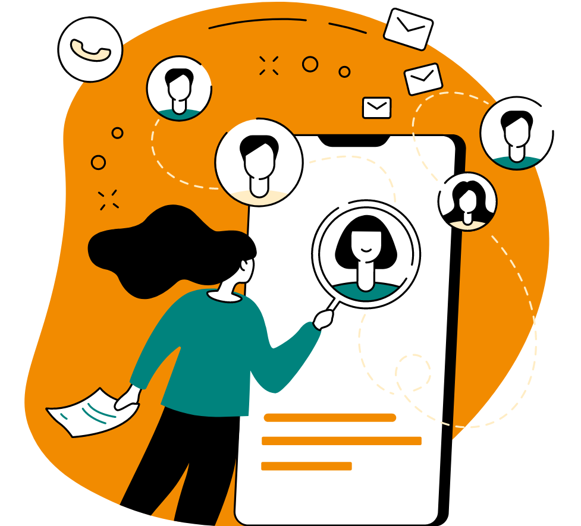
“It is now estimated that 72 million pieces of personal data will be collected on every child around the world before their 13th birthday”
Source: Washington Post, “Your kids’ apps are spying on them”

Slide 15

As technology evolves, it's raising some big questions that we have yet to answer.
What do you think?

Slide 16
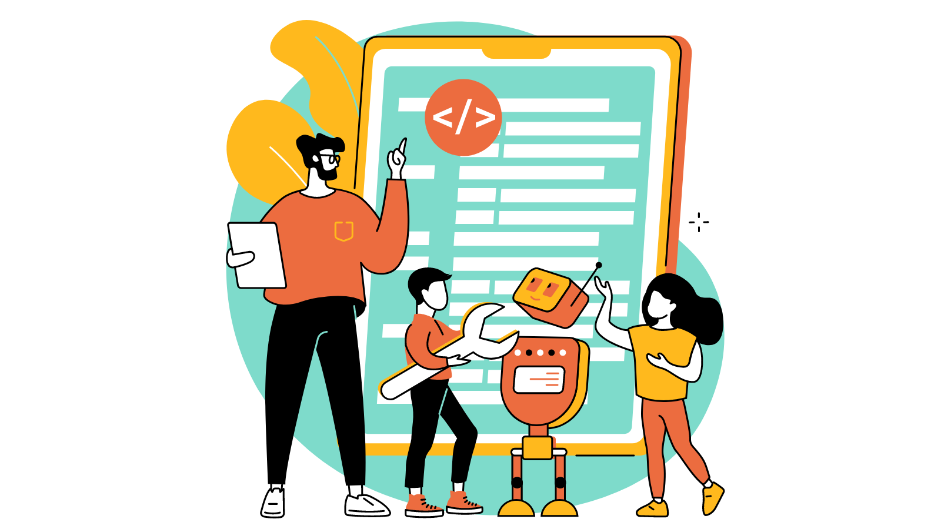
Age verification
Some people believe that parental consent should be obtained for all children under a certain age, like 13 or 16.
Others think it’s best to leave it to young people to exercise their own judgment, depending on their level of maturity.
Others think young people should be barred from adult content on the internet altogether.

Slide 17
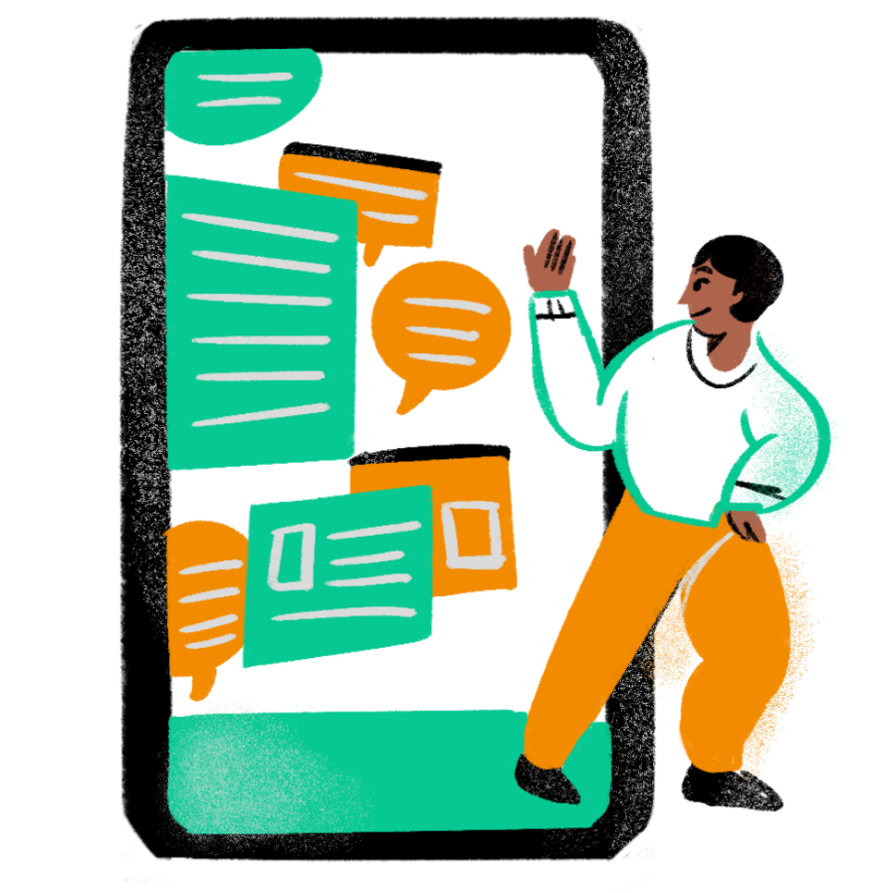
Right to be forgotten
Countries around the world have developed, or are thinking of developing, laws to protect young peoples’ rights to erase their personal information on the internet.
But this can be difficult when the information has already been spread to other platforms.
Erasing information can also be tricky when you consider other people’s freedom to express themselves, or to say things they feel are meaningful and important.

Slide 18
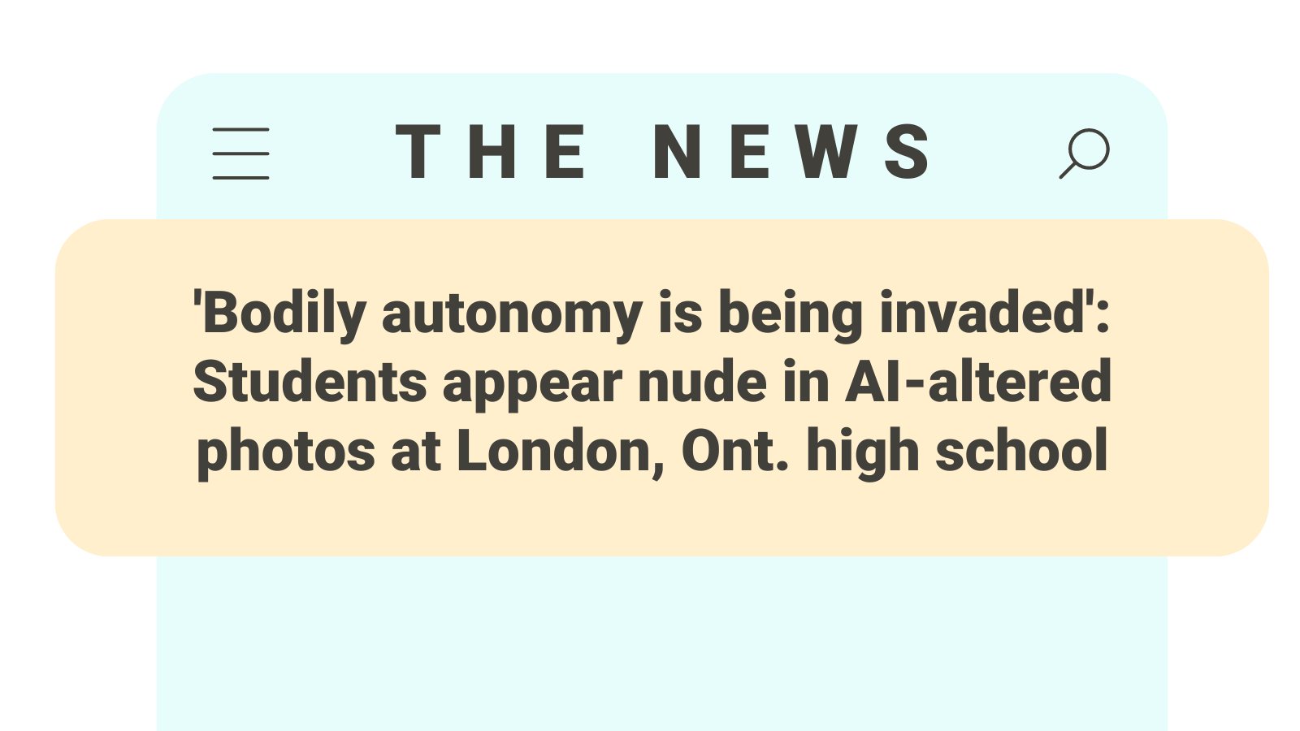
AI and cyberbullying
AI has been used to create fake images about people that can be hurtful and inappropriate.
In Canada, there are laws against posting real intimate images of other people on the internet without their consent.
Some provincial laws also extend protections to address the harms from fake intimate images that have been posted without consent.
Source: CTV News, 2024

Slide 19

What can you do?

Slide 20
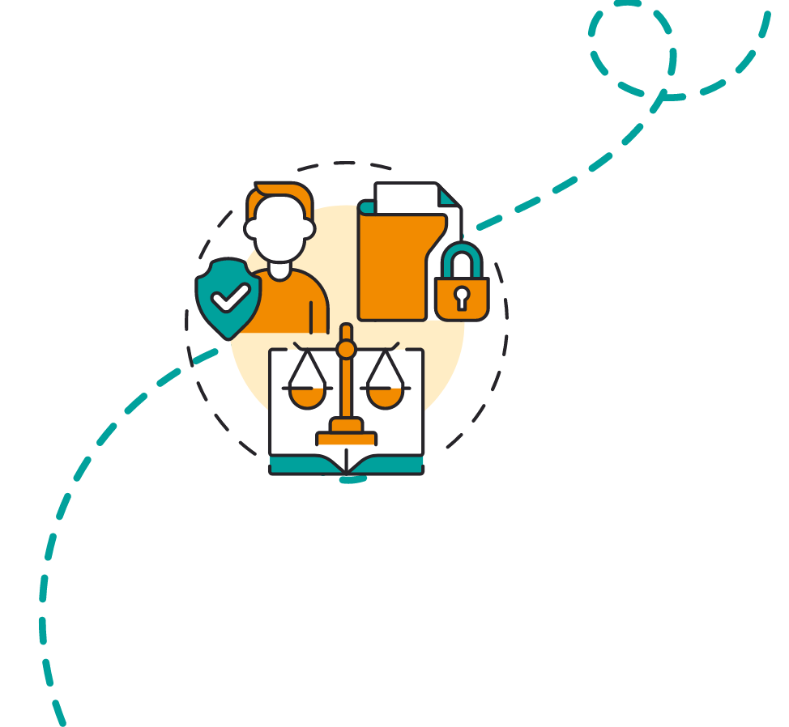
Remember:
Be cautious and thoughtful, as what you post can have unintended consequences.
Keep in mind what you post online is not always private.
Even if you delete something, there is no guarantee it’s gone.
Control your digital footprint and adjust your privacy settings.

Slide 21
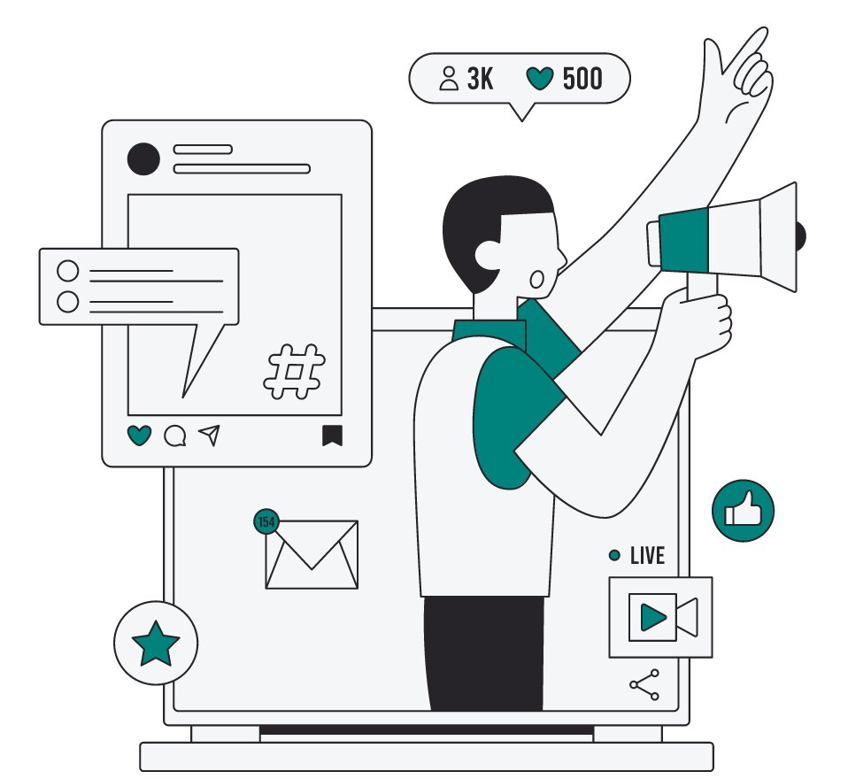
Remember:
What you post can affect others and their privacy. Show respect and responsibility.
When in doubt, seek guidance from trusted adults.
Speak out against cyberbullying and online harassment when you see it.

Slide 22
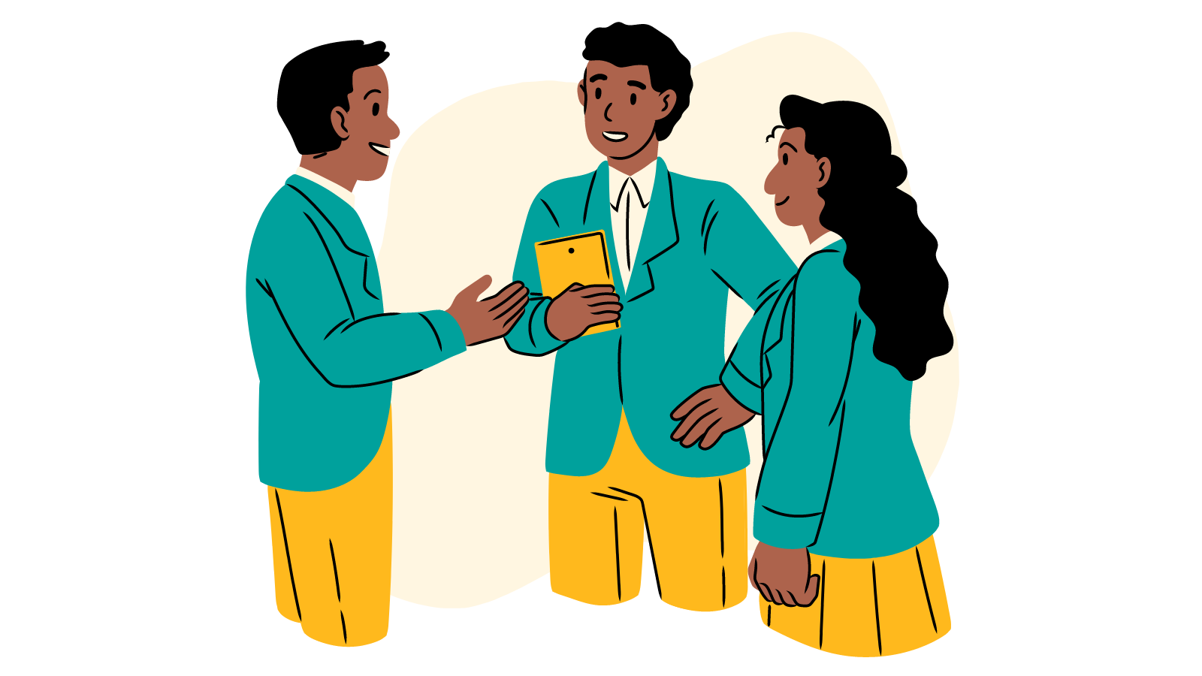
What are some other ways you can protect your privacy and personal information?
DISCUSSION QUESTION

Slide 23

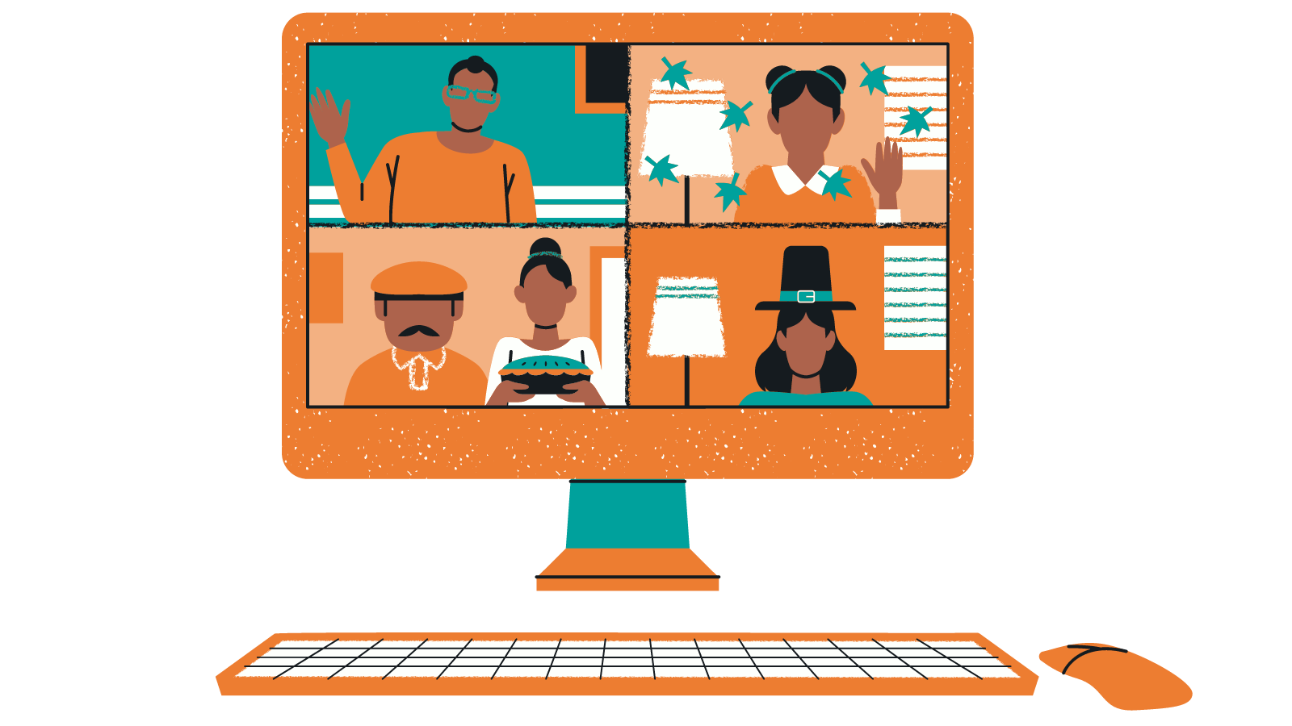
More resources

Slide 24
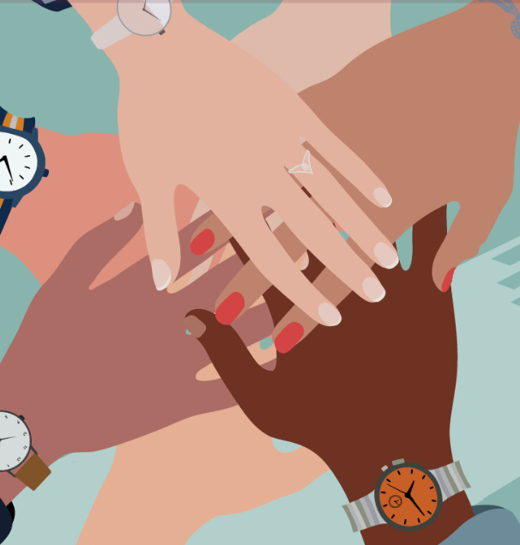
Digital Privacy Charter for Ontario Schools
We know that our schools play an essential role in preparing us to be safe and responsible digital citizens and empowering us to exercise our privacy and access rights.
This is why the IPC developed a Digital Privacy Charter for Ontario Schools.
The charter consists of the following 12 high-level commitments that Ontario Schools can pledge to support students.
The commitments are based on requirements under the Municipal Freedom of Information and Protection of Privacy Act (MFIPPA).
Encourage your school to sign on!

Slide 25


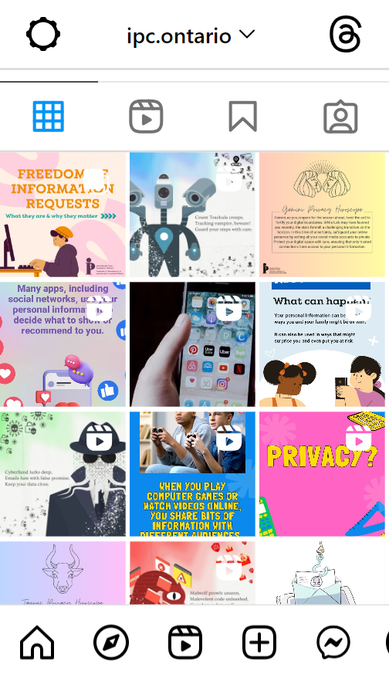
Follow the IPC on Instagram!
@ipc.ontario

Slide 26

Check out the IPC podcast, Info Matters
Some episodes you may enjoy:
  Teenage confidential: Teens, technology, and privacy
  In their own words: Students from Westboro Academy speak out about privacy
  Empowering young women and girls in the digital world
  From high school to university: a young person’s perspective on digital privacy
  Teaching kids about privacy

Slide 27


Questions?
Comments?
CONTACT THE IPC
Youth Advisory Council Contact
youthcouncil@ipc.on.ca
@
IPC General Contact
info@ipc.on.ca
@
Toronto Area:
Long Distance:
TDD/TTY:
(416) 326-3333
1 (800) 387-0073
(416) 325-7539
Suite 1400
2 Bloor Street East
Toronto, Ontario
M4W 1A8
YOUTH ADVISORY COUNCIL
INFORMATION AND PRIVACY COMMISSIONER OF ONTARIO
STRATEGIC PRIORITY: CHILDREN AND YOUTH IN A DIGITAL WORLD

